Slide 1
Water Potability Prediction
SAI ASHRITH H M

Slide 2

AGENDA
Introduction
Dataset Overview
Data Preprocessing
Model Selection
Model Evaluation
Results & Insights
Conclusion & Future Work
Q&A

Slide 3

INTRODUCTION
Opening Statement: Access to clean and safe drinking water is crucial for human health. However, contamination from chemical and physical pollutants poses a significant public health risk. Traditional water quality assessment methods are resource-intensive, making automated predictive models essential.
Objective: This project aims to develop a machine learning model to predict water potability based on key physicochemical parameters.

Slide 4
DATASET OVERVIEW
The dataset contains 9 key water quality parameters used to predict whether water is potable (safe to drink) or not. These parameters include:
pH – Measures acidity/alkalinity, crucial for water safety.
Hardness – Indicates dissolved minerals, affecting taste and plumbing.
Solids (TDS) – Excess levels can impact health and water quality.
Chloramines – Used for disinfection but harmful in high amounts.
Sulfate, Conductivity, Organic Carbon, Trihalomethanes, and Turbidity – Critical indicators of contamination and treatment effectiveness.
The target variable is Potability (1 = potable, 0 = not potable).

Slide 5
DATA PREPROCESSING
Handling Missing Values:
Used imputation techniques to fill missing data for accurate analysis.
Checked for missing values in key features like pH, Sulfate, and Trihalomethanes.
Feature Scaling & Normalization:
Applied Min-Max Scaling to standardize numerical features.
Ensured all features have a consistent scale for better model performance.
Outlier Detection & Removal:
Identified and addressed extreme values in parameters like TDS and Conductivity.
Used visualization techniques (boxplots, histograms) to detect anomalies.
Feature Engineering & Transformation:
Analyzed feature importance to remove redundant or less impactful variables.
Created new derived features (if applicable) to enhance predictive power.
Data Splitting:
Divided the dataset into training (80%) and testing (20%) sets.
Ensured a balanced distribution of potable and non-potable samples.

Slide 6
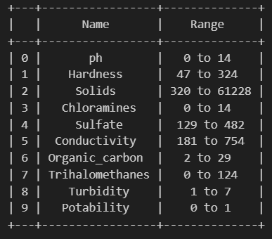
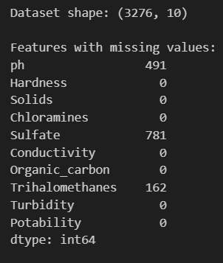
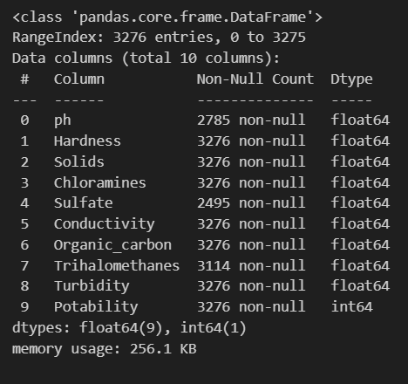
Range of the features
Missing values in the features
Meta Data of the Dataset

Slide 7
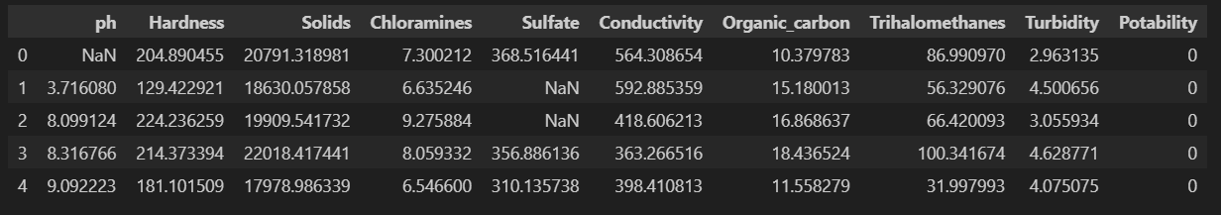
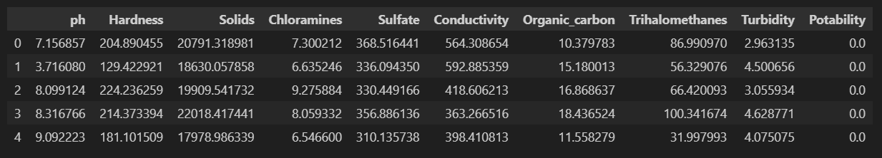
KNNImputer

Slide 8
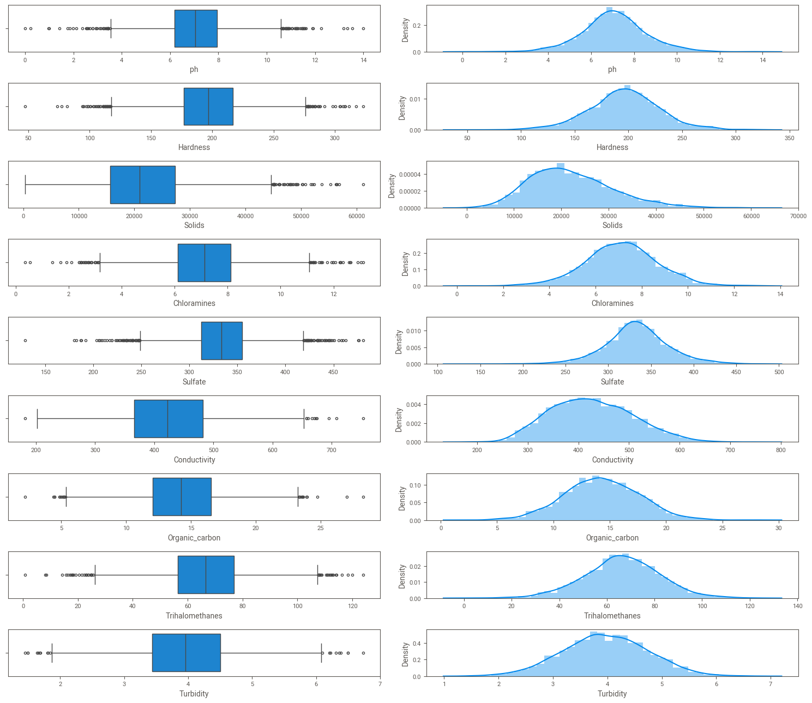
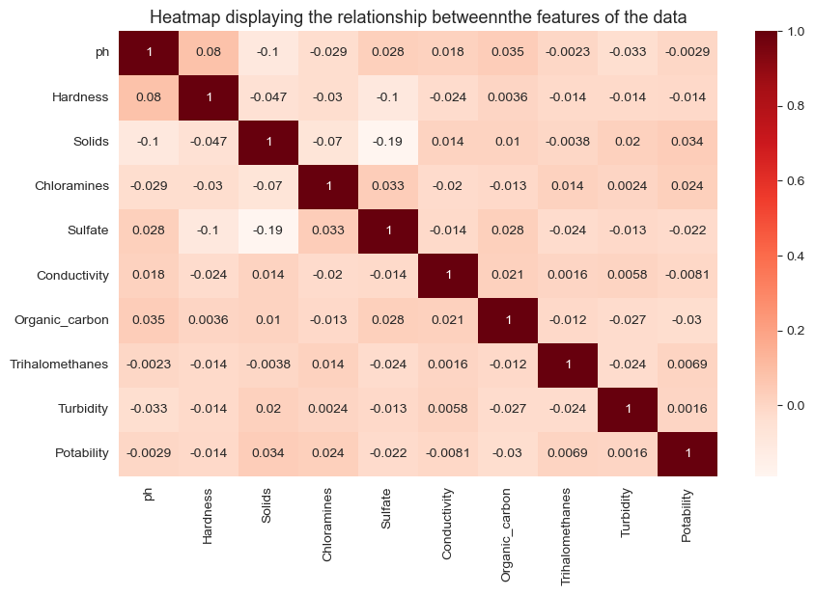
Outliers and Data Distribution
Checking for Corelation

Slide 9
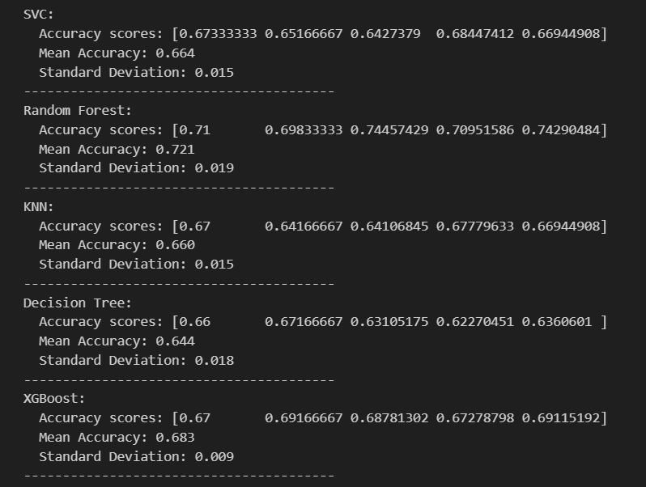
MODEL SELECTION
I have evaluated multiple machine learning models for water potability prediction, using accuracy as the primary metric. The results are as follows:
Support Vector Classifier (SVC): 66.4% accuracy
K-Nearest Neighbors (KNN): 66.0% accuracy
Decision Tree: 64.4% accuracy
XGBoost: 68.3% accuracy
Random Forest: 72.1% accuracy (Best Performing Model)
Why Random Forest?
Highest accuracy (72.1%) among all models.
Robust to overfitting due to ensemble learning.
Handles missing values and noisy data effectively.
Thus, Random Forest was selected as the final model for water potability prediction, ensuring a balance between accuracy, interpretability, and reliability.

Slide 10
Hyperparameter Tuning: Optimize models with RandomizedSearchCV.
Hyperparameter Tuning: Optimize models with GridSearchCV.

Slide 11
MODEL EVALUATION
Performance Metrics Used:
Accuracy: Measures the overall correctness of predictions.
Precision & Recall: Assesses the reliability of potable vs. non-potable classifications.
F1-Score: Balances precision and recall for a more comprehensive performance measure.
Standard Deviation: Evaluates consistency across multiple runs.
Confusion Matrix Analysis:
Provides a detailed breakdown of true positives, true negatives, false positives, and false negatives.
Helps identify misclassification patterns in potable and non-potable water predictions.
Demonstrates how well the model distinguishes between the two classes.
ROC Curve & AUC Score:
ROC (Receiver Operating Characteristic) Curve visualizes the model’s ability to differentiate between potable and non-potable water.
AUC (Area Under Curve) Score indicates the model's predictive power – a higher AUC means better performance.
The Random Forest model achieved a strong AUC score, confirming its reliability.
Final Model Selection:
Random Forest was chosen for its superior accuracy, robustness, and strong performance in distinguishing potable and non-potable water.
It provides a balanced trade-off between precision and recall, ensuring effective classification.
These evaluations confirm that Random Forest is an effective and reliable choice for water potability prediction.

Slide 12
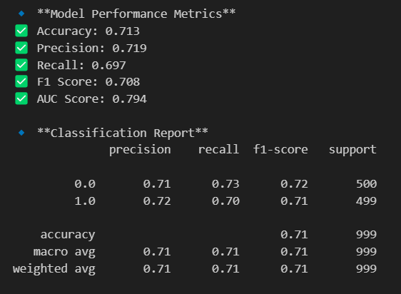
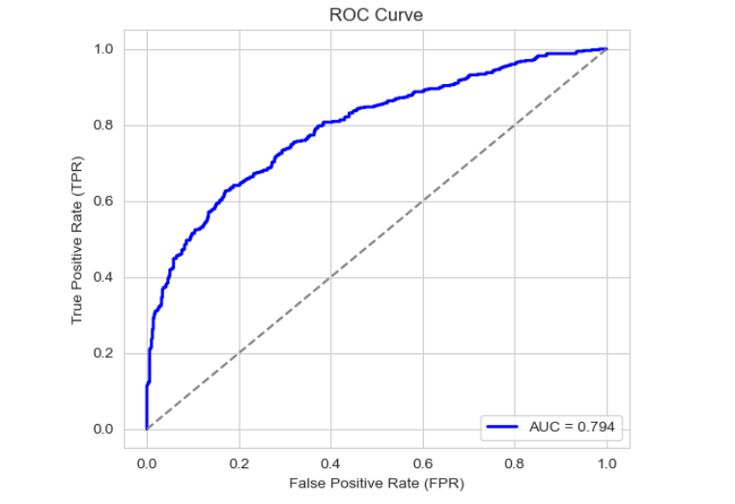
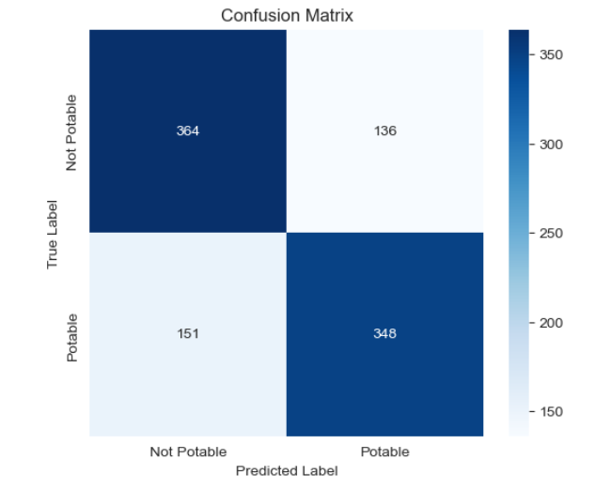

Slide 13
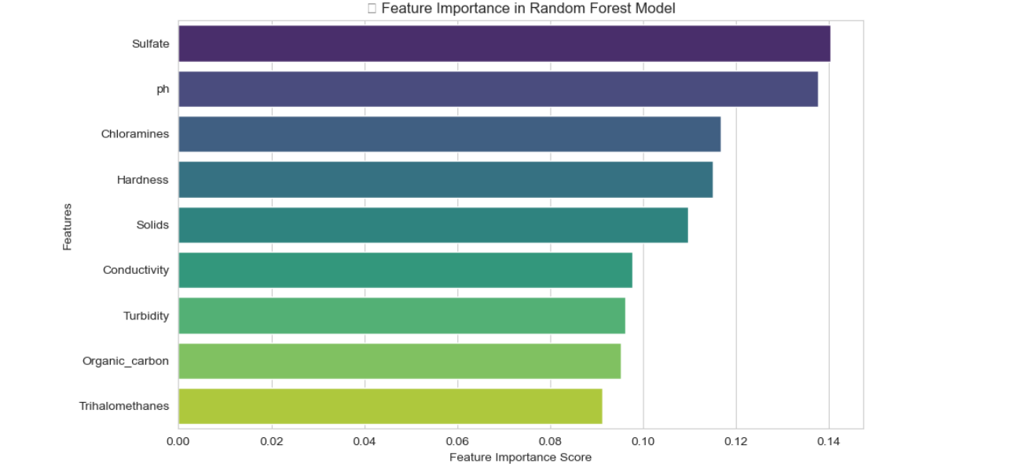
Feature Importance: Analyze and visualize feature importance in Random Forest model.

Slide 14

RESULTS & INSIGHTS
Model Performance:
Random Forest achieved 72.1% accuracy, making it the best-performing model.
The model showed consistent performance across multiple evaluation runs.
Key Feature Insights:
pH, Total Dissolved Solids (TDS), and Conductivity were the most influential factors in determining water potability.
Turbidity and Organic Carbon had a moderate impact on classification.
Some features contributed less, indicating potential for feature optimization.
Confusion Matrix Analysis:
The model correctly classified most potable and non-potable water samples.
ROC Curve & AUC Score:
The high AUC score confirms that the model effectively distinguishes between potable and non-potable water.
Limitations & Areas for Improvement:
Accuracy can be further improved with more diverse and balanced data.
Additional feature engineering and hyperparameter tuning may enhance predictions.
Integration with real-time sensor data can improve practical applications.
These insights validate the effectiveness of Random Forest for predicting water potability while highlighting future enhancement opportunities.

Slide 15
CONCLUSION & KEY FINDINGS
The analysis of water potability prediction reveals that key water quality parameters—such as pH, hardness, total dissolved solids (TDS), chlorides, sulfates, and microbial contamination—significantly influence whether water is safe for consumption. Machine learning models applied to the dataset suggest that water quality classification can be effectively performed using algorithms like Random Forest, XGBoost, and Support Vector Machines, with Random Forest often demonstrating superior predictive performance.
KEY FINDINGS INCLUDE:
pH Levels: Water with extremely low or high pH values is more likely to be non-potable, aligning with WHO guidelines.
Total Dissolved Solids (TDS): High TDS concentrations are a strong indicator of non-potable water, as they correlate with increased contamination and mineral content.
Chemical Contaminants: Elevated sulfate and chloride levels negatively impact water quality, making them crucial features in predictive modeling.
Microbial Contamination: Presence of bacteria is a critical determinant of potability, though not always captured in available datasets.

Slide 16
BUSINESS AND PRACTICAL IMPLICATIONS
Automated Water Quality Monitoring: Implementing machine learning models can help automate real-time water quality assessments.
Targeted Water Treatment Strategies: Identifying specific contaminants allows for more efficient purification techniques.
Improved Public Health Measures: Predictive models can help in proactive identification of unsafe water sources, reducing health risks.
In conclusion, predictive modeling for water potability serves as a valuable tool for ensuring water safety. However, model performance depends on the completeness and quality of the dataset, highlighting the need for continuous data collection and validation through laboratory testing.

Slide 17

Questions ?

Slide 18
Thank You!

